Slide 1

VRM and the ABCFP
Case in Point FPB #195
North Island – Central Coast Resource District
Mike Larock, RPF
Director of Professional Practice and Forest Stewardship

Slide 2

Professional Reliance means ….
1. PR = Accountability = Discipline
2. Free at Last. – you cannot question my work
3. Change how we do things
4. Change the steward
5. Competence: High level of exactness
6. Denial
PR = Judgement x Accountability
2

Slide 3
ABCFP and FPB #195
Social licence
Foresters Act
Pursuing Public Trust
What is the ABCFP doing?
3

Slide 4
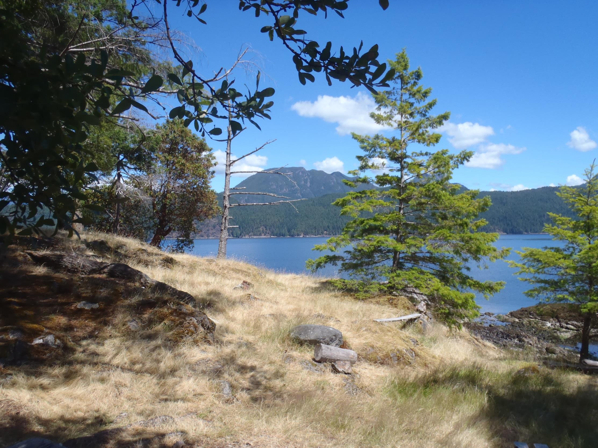
SOCIAL LICENCE
SL = authority + credibility + trust

Slide 5
SL = authority + credibility + trust
Foresters Act
Exclusive Practice
Self-Regulation
Competent Practice
Public Interest
5

Slide 6
FPB #195
Failure to meet the objectives of visual quality
Primary Cause of failure
  Licensee reliance on unsound professional assessments
  Licensee refusal to engage in dialogue
6

Slide 7
SL = authority + credibility + trust
What is the ABCFP required to do?
Enforce the Act
  Foresters Act – professional service required,
  to complete a plan
  to incorporate Visual Assessment
  to implement the plan
  to measure results
  - practice standard
  - practice in the public interest
  - administrative fairness
7

Slide 8
SL = authority + credibility + trust
Follow up on allegations
  Provide disciplinary actions or sanctions
  Clarify the professional involvement
Competence within professional service
Report with accuracy
8

Slide 9
SL = authority + credibility + trust
Science
Competence – adequate knowledge
principles (currency, methods, peer review, documentation)
Professional Independence
objective application of professional judgement and expert knowledge in a given set of circumstances
Social Expectations
goals, values, management
9

Slide 10
SL = authority + credibility + trust
11 Code of Ethics:
rules in making moral choices
12 Standards of Professional Practice:
measures of performance
10

Slide 11
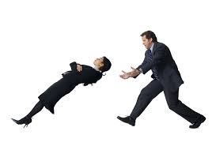
SL = authority + credibility + trust
trust
a confident expectation
public trust
“exclusive right to practice in exchange for practice in the public interest”
10

Slide 12
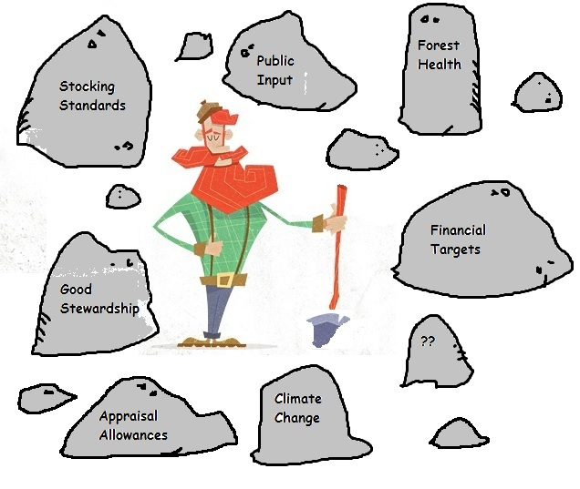
Managing Requirements
11

Slide 13
The ABCFP
Pulling together the relevant information from the FPB
  Information behind the allegations
  Complete profession’s obligations
Working on preliminary guidance for professional service in VRM
Participate as a partner in training professionals regarding VRM
12

Slide 14
For more information, contact the Professional Practice and Forest Stewardship Team
www.abcfp.ca

